Slide 1
THREAT MODELING PROCESS AND ITS BENEFITS
Unit - III

Slide 2
Identifying the Threats by Using Attack Trees
An attack tree is a tree of (potential) attacks divided into branches. It starts at a main or master node and has branches from it. Branches can have multiple sub-branches. Each node/branch represents a (potential) attack.
Creating an attack tree involves the following steps:
Step 1: Identify the Goal
Step 2: Define the Root Node
Step 3: Identify Attack Paths
Step 4: Subdivide Attack Paths
Step 5: Add Attack Techniques and Vulnerabilities
Step 6: Assess and Analyse

Slide 3
Rating Threats Using DREAD:
DREAD stands for
D – Damage potential
R – Reproducibility
E – Exploitability
A – Affected users
D – Discoverability

Slide 4
Risk Mitigation Techniques and Security Best Practices:
1. Accept the Risk
An organization may choose to simply accept risk under these scenarios:
The risk is considered low (e.g., the value of an asset is low and the probability of threats affecting the asset are acceptable).
The cost of accepting the risk is found to be lower than the cost of transferring or limiting the risk.
2. Transfer the Risk:
When the risk is transferred, the risk is shared with a third party in part or in whole. This is typically seen in the use of insurance. Third-party insurance organizations, for a fee, agree to accept the risk and compensate the information owner for the full damage of a particular risk.

Slide 5
Risk Mitigation Techniques and Security Best Practices:
3. Limit the Risk:
When a risk is high for a particular asset, and the risk cannot be transferred (i.e., not practical or cost effective), then the risk should be limited in part or in full. The process includes identifying the most probable threats to a given asset and identifying, researching, or developing an acceptable control to that threat.
4. Avoid the Risk
Avoiding risk means changing plans to prevent any exposure to it, often used when the risk is high and unacceptable.

Slide 6
AUTHENTICATION
Authentication is the process of determining whether someone or something is who or what they say they are. Authentication technology provides access control for systems by checking to see if a user's credentials match the credentials in a database of authorized users or a data authentication server.

Slide 7
Different types of authentications?
Single-factor authentication
Two-Factor Authentication (2FA)
Multifactor authentication
One-time password
Three-factor authentication
Biometric authentication
Mobile authentication
Continuous authentication

Slide 8
AUTHORIZATION:
Authorization is the process of giving someone the ability to access a resource.
Types of authorization:
Role-Based Access Control (RBAC)
Attribute-Based Access Control (ABAC)
Relationship-Based Access Control (ReBAC)

Slide 9
Defense In Depth:
Defense in Depth is a cybersecurity strategy that uses multiple layers of security controls to protect information and systems. If one layer fails, the next layer will still protect the system.
Example of a Mobile phone:
A PIN or biometric lock is used to restrict unauthorized access (access control).
Antivirus software is installed to detect and block malware (endpoint security).
Installation of unknown or untrusted applications is avoided (user awareness).
Important data is regularly backed up to secure cloud storage (data protection).

Slide 10
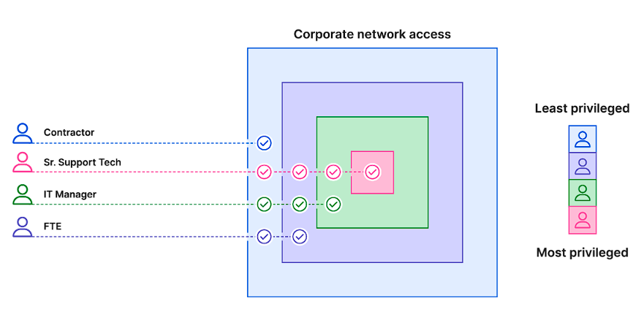
Principle of Least Privilege:

